Slide 1
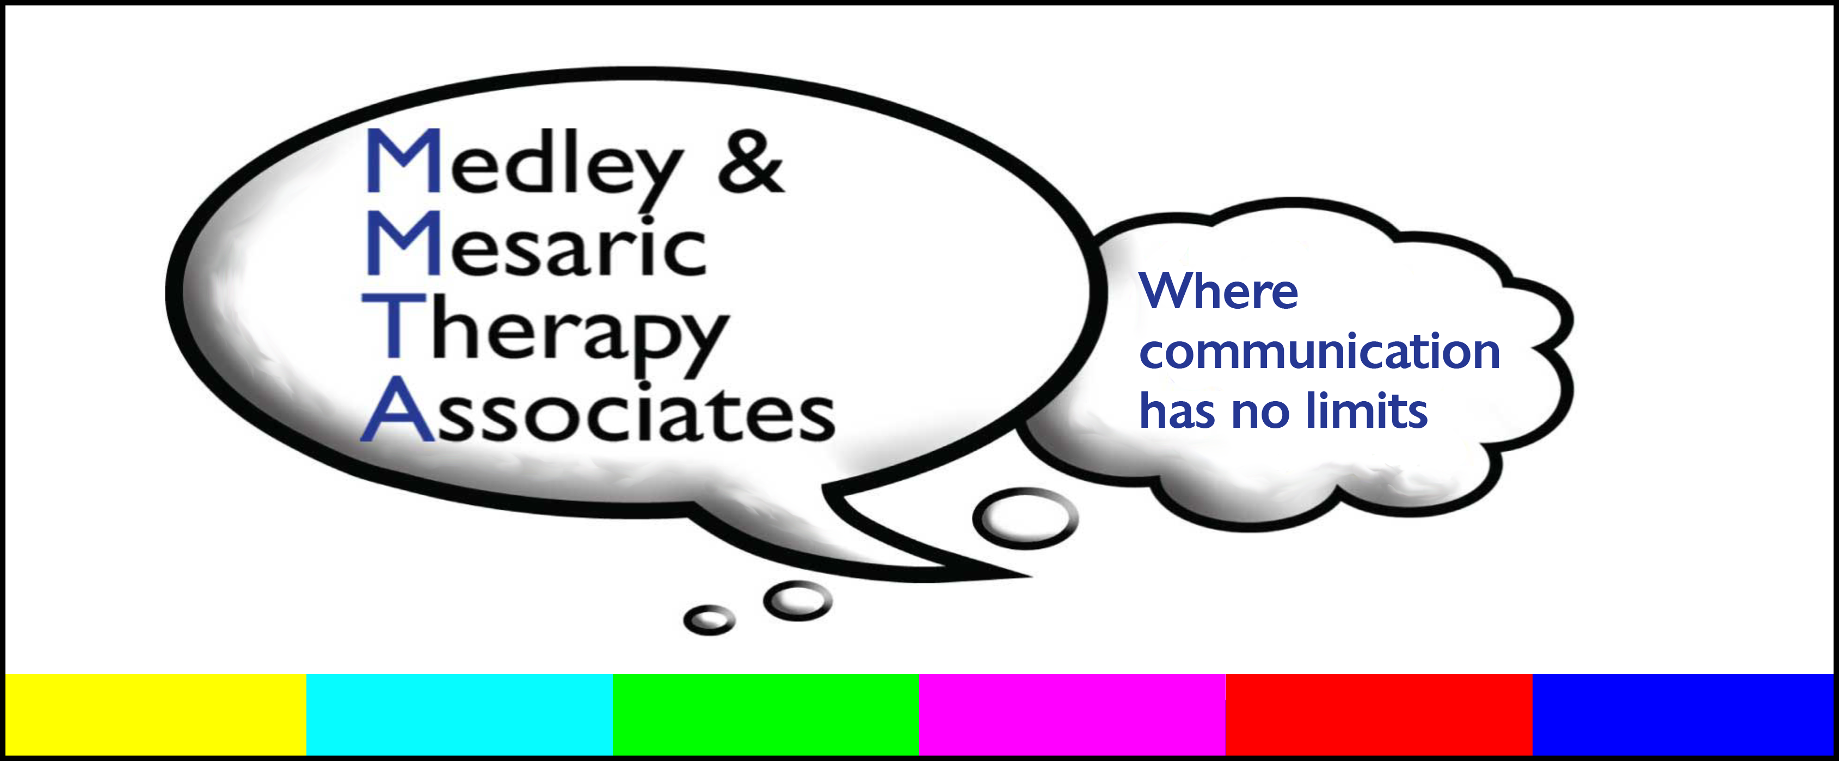
All Behavior is Communication, and
Most Communication is Social
Presented to: Wallingford-Swarthmore School District
Instructional Assistants
Location: Strath Haven Middle School, Wallingford, PA
Date: November 2, 2021
Presented by: Lynn Medley, M.S., CCC-SLP
421 N Bethlehem Pike
Ambler, PA 19002
215-643-5585
www.mmtaspeech.com

Slide 2


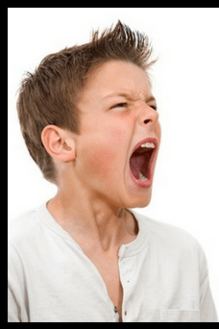
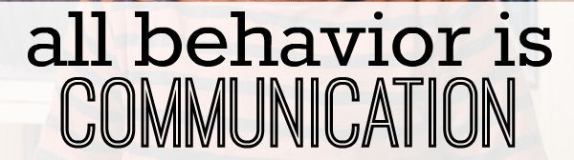

Slide 3
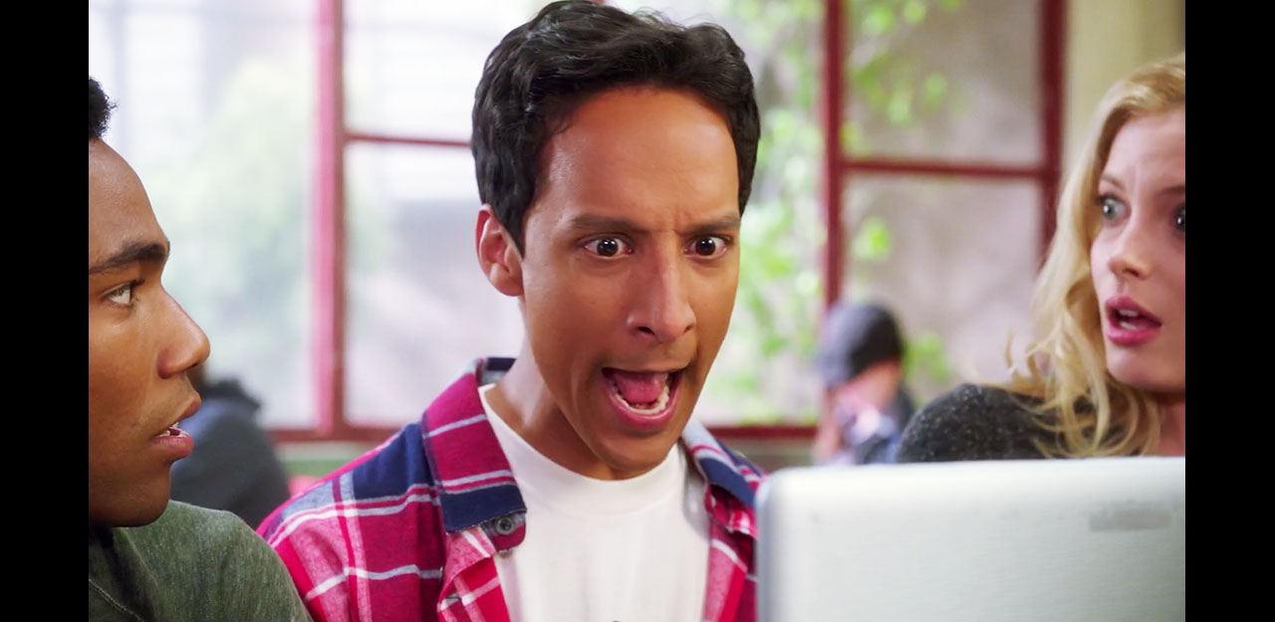
And most communication is social, either because you intend it to be, or because it has a social consequence.

Slide 4

The behavior of students with social deficits is usually communicating that:
Their social-emotional development is younger than their age (no matter what their IQ is)
They are missing particular skills that impede their ability to join and stay in social interaction with “neurotypicals” (NTs)
    What skills they’re missing are likely to depend on their diagnosis/educational classification/learning style
Let’s start with #1 - social-emotional development

Slide 5
What do you mean by “Social”?
Rote Social “Behaviors”
Socio-Emotional Regulation
Social Connection
Social Problem
Solving

Slide 6
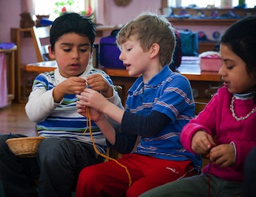
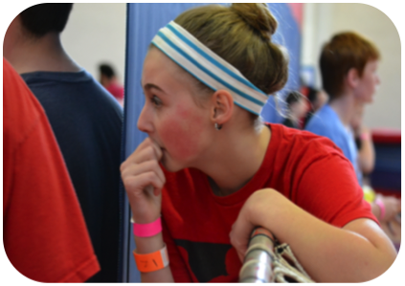
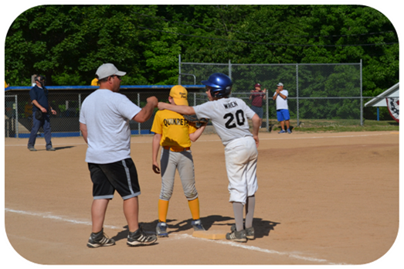

In typical development…
Years
10+
9
8
7
6
5
4
3
2
1
<1
Social
Behavior
Socio-
Emotional Regulation
Social Problem-Solving
Social Connection
Perspective-Taking Skill

Slide 7
Socio-Emotional Age:
In typical development, what age child uses these coping strategies?
Has a throw-a-toy tantrum?
Hides when embarrassed or frustrated?
Pouts/gives the silent treatment?
Says someone’s mean when they don’t respond the way they expect?
Blames someone else for what they’ve done?

Slide 8
Socio-Emotional Age Pro-Tips: What to do when you see an immature coping strategy?
Just notice it.
Don’t comment on it.
Think to yourself (never say to the student), “Huh. That’s an X-year-old’s strategy. That tells me something about how mature their social strategies are.”
Know that students use younger strategies when they are out of resources.
Assume they need your help.

Slide 9
Reasons Students Use Immature Strategies
They don’t know a better strategy and this strategy sometimes works
They don’t know or don’t “care” about the social consequences
    They might not be able to see that far ahead
    They may not be able to take the perspectives of others
    They may not have experience with good social consequences, so they don’t know what they’re missing
They know a better strategy, but can’t tolerate a feeling they’re having and act impulsively

Slide 10
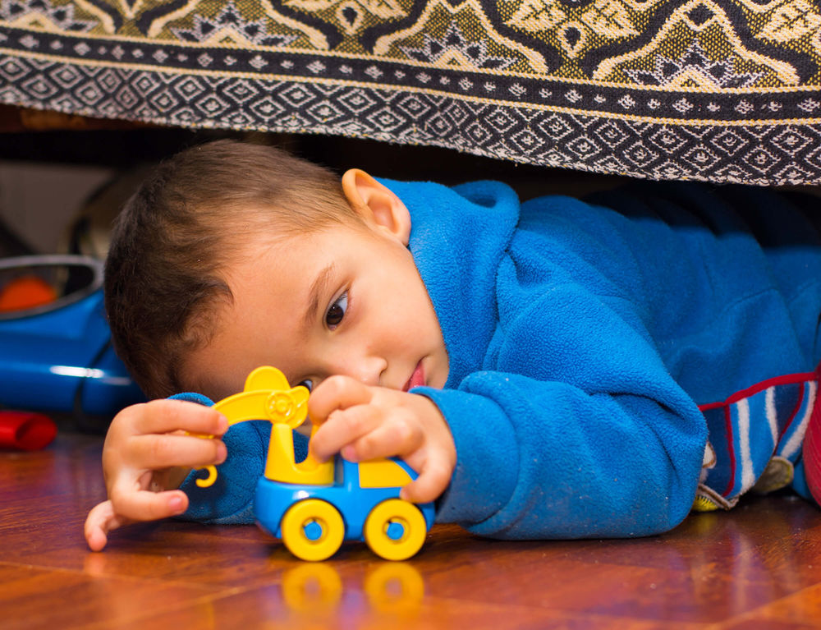
What if what they’re doing doesn’t look like any age child
Then their behavior is linked more to their learning style than to a delay in skill.
Which leads us to learnig style.

Slide 11
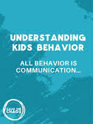


Slide 12
The behavior of students with social deficits is usually communicating that:
Their social-emotional development is younger than their age (no matter what their IQ is)
They are missing particular skills that impede their ability to join and stay in social interaction with “neurotypicals” (NTs)
    What skills they’re missing are likely to depend on their diagnosis/educational classification/learning style
Now for #2 – learning style

Slide 13
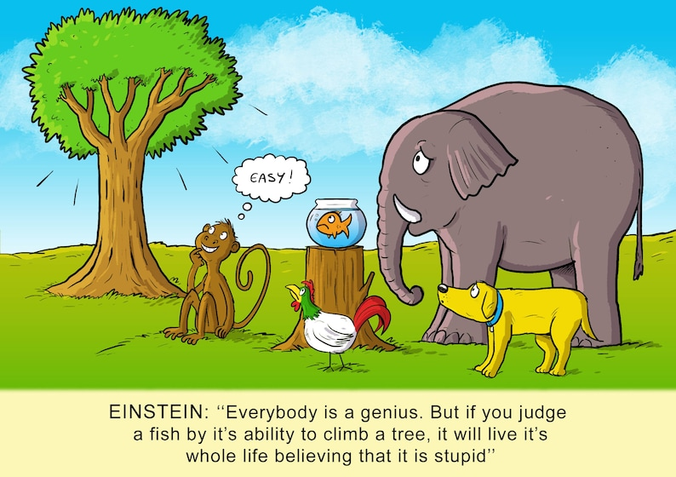

Slide 14
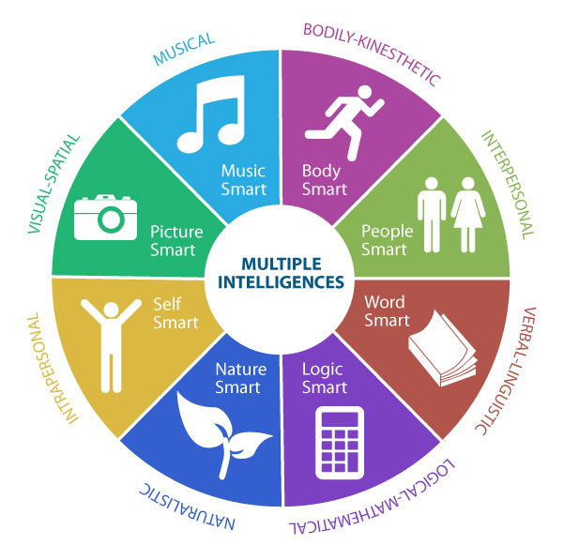
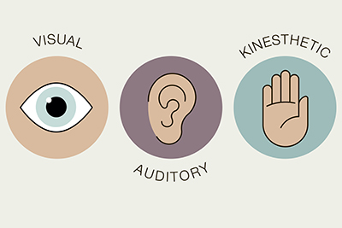
What is “learning style”?
For today’s purposes,
The way students approach or avoid learning and interacting with others based on their strengths and their weaknesses.

Slide 15
Know How Your Student Ticks, and Why
ES
AS
It’s me against the world
I lead with emotions
I have to make things happen to get my needs met
I know enough about what you’re thinking to plan around it
People are often obstacles to my getting what I need
I have to figure this world out by myself
I lead with logic and rules
What I’m doing isn’t related to what anyone else is doing
I don’t know what you’re thinking
I’m learning by trial and error, I don’t see people as helpful

Slide 16
And within these learning styles are deficits often associated with ADD:
Processing sensory information
Awareness of what’s happening around them
Sustaining attention
Organizing thoughts and materials
Getting started
Shifting from one thing to another in someone else’s time frame
Knowing how much time has passed

Slide 17

Learning style can help you decide why a student might be doing what they’re doing
ES
AS

Slide 18
Learning Style Pro Tip:
Ask yourself – does this student, in this moment, have all the information I think they have?
Do they know what the other people are thinking?
Do they know what the other people know?
Do they have enough resources to care about the other person or are they working too hard to take care of themselves?
Do they really understand the consequences of their behavior?

Slide 19
What is your job?
Keeping students safe
Preparing students to learn
Helping students participate
Supporting teachers and their plans

Slide 20

But what are your superpowers?
Observation
Setting the tone
Building relationships
Organizational skills
  Class materials
  Providing the big picture and the next steps
  Encouraging peers to do something differently
    Change the game
    Give positive feedback
    Give occasional gentle feedback
  Encouraging your student to try something new

Slide 21



Keep in mind – it is a lot to ask of a student with social impairment to be the one who solves all the problems…

Slide 22
Let’s think through some of the things you see with your students
#1: Student’s Social-Emotional Age
#2: Student’s Learning Style
#3:
Your superpowers

Slide 23
In case you couldn’t think of any…
Over-focus on winning/not losing
Not joining in on the playground/lunch/clubs
Staring/stalking
Rule police
Only stays involved in groups briefly

Slide 24
Pro-tip: Plan for the worst day and expect the best day
In other words, don’t judge a student by their worst days, but have a plan ready should they occur.
Don’t take away a student’s supports because they “shouldn’t” need them. If you find yourself saying, “But they CAN do it….” then adapt to say, “What do they need today to be able to do it?”

Slide 25
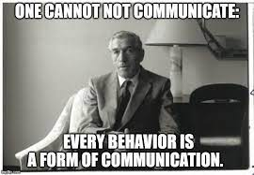
And most communication is social…

