Slide 1
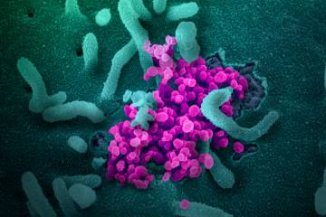
COVID-19 and Child/Adolescent Mental Health
Board Focus Topic
April 26, 2021
Mrs. Marlena O’Kane
Mrs. Jenna Grabiak
Dr. M. McCullough

Slide 2

Behavioral Health Department
Goal: Provide comprehensive and effective school counseling and mental health services within the district using a coordinated, systematic approach.
  Proactive Universal Supports
  Trauma-Invested Practices
  Tiered System
  Student-Centered
  Part of WSSD Culture and Conversation

Slide 3
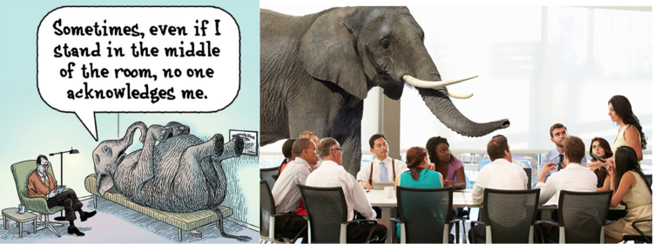

From Behavior to Behavioral Health: An Evolution
“No One Ever Asked Me.”

Slide 4

Positive Aspects
Demonstrated the Resiliency of Children and Adolescents
Encouraged families to Seek Help
Changed the Conversation about Mental Health
Schools became the Anchor

Slide 5
How is the Covid-19 pandemic affecting adolescents?
Greatest impact stems from:
  School closures
  Being in the house with family members
  Not getting to see friends and peers
Developmental tasks of adolescence:
  Develop social skills and empathy
  Develop a sense of identity
  Sense of time differs from adults. They live their lives in a series of events (that might not be happening).

Slide 6

Pandemic Challenges
Change in routine
Break in continuity of learning
Break in continuity of health care
Missed significant life events → Grief
Loss of security of safety
Challenges in lower-income communities

Slide 7
Change in routine
Physically or socially distancing from someone you love-friends, boyfriend/girlfriend, family or worship community is really challenging for teens.
Adolescents might struggle with having to skip social gathering or wearing masks.
Important for adults to helps teens safely connect with family and friends remotely.
Establishing some sort of routine is important, including a time for schooling (hybrid or virtual) and exercise and an opportunity to leave the house.
SLEEP SCHEDULES-one of the most important things to establish. Adolescents need 9-10 hours per night. Less could lead to higher stress levels and lower levels of cognitive functioning.

Slide 8
Break in continuity of learning
Immediate need for virtual learning brought to light inequity in resources, access and connectivity across families and communities.
School closures might have caused a break or disruption in supplemental services (occupational, behavioral or speech therapy).
Impact on adolescents’ development of athletic or hands-on vocational skills.
“Zoom fatigue”
Stress around going back in-person or switching to virtual.

Slide 9
Break in continuity of health care
Parents may have avoided seeking routine health care (dental, eye, immunizations, pediatric well-visits) due to stay-at-home orders.
School closures lessened their ability to receive mental health services that might have been offered in school.
Continuity of health care in all capacities (mental, physical) should be a priority.

Slide 10

Missed significant life events → Grief
Feeling of placing life “on-hold”.
Birthdays, graduations, proms, vacations, births and funerals are some examples of the many significant life events that teens might have missed.
Grief is a very real response to these losses.
Elisabeth Kubler-Ross 5 stages of grief:
  Denial
  Anger
  Bargaining
  Depression
  Acceptance
  * Most teens are stuck in anger/depression stages

Slide 11
Loss of security and safety
Job loss has affected many families during the pandemic.
Economic insecurity is linked to adverse development, academic achievement, and health outcomes.
Economic stressors could increase risk to exposure to violence.
Along with stay-at-home orders, some adolescents may have been increasingly exposed to abuse and neglect, and increased rates of domestic and sexual violence.
  * However, calls to CYS have plummeted, mainly because these students are not around those adults who typically report to CYS (teachers, counselors, school personnel).

Slide 12
Challenges in lower-income communities
Pandemic is highlighting a lot of societal divides in the way it is disproportionately impacting lower-income families.
Stress and trauma is higher
More food insecurity, housing instability, loss of income, and higher rates of illness and death.
Barriers to support
Older children taking care of younger children might have less time to concentrate and keep up with schoolwork.

Slide 13

What can you do as parents/caregivers?
Maintain as normal a routine as possible
Be alert for changes in behavior
Talk, listen, and encourage expression
Give honest and accurate information
Teach simple steps to stay healthy
Reassure children about their safety
Always be willing to have a conversation about what they might see/hear on the news, social media outlets etc.

Slide 14
Recognize and address fear and stress
Adolescents can be very overwhelmed when stress is related to a traumatic event
Students are experiencing traumatic stress from seeing/hearing an overabundance of Covid-19 news in the media.
Particularly, when students see/hear about death often in the news, they associate it with potential death in their own neighborhood=toxic stress.
A concept that may be misunderstood, involves the vulnerability of the human brain to be negatively impacted by traumatic events even if we haven't personally experienced them. This concept is called vicarious traumatization.
Vicarious traumatization has given us an understanding that witnessing or even just having knowledge of the events can have negative consequences on our mental health.
This feeling might be expressed as :
  Anger/frustration
  Worry
  Sadness
  Unhealthy eating/sleeping habits
  Difficulty with attention and concentration
  Isolation

Slide 15
Teach and reinforce everyday preventative actions
Encourage adolescents to be good role models of behavior by encouraging:
  Mask wearing
  Hand-washing
  Social distancing
  Limiting attendance at larger gatherings
  Be mindful that adolescents might want to follow what their peers are doing. Stay in communication with other families if possible about group behaviors.

Slide 16
Help adolescents stay socially connected
Encourage adolescents to reach out to friends and family via phone, video chats, and social media.
Be willing to make some changes in terms of what you find acceptable screen-time use.
More important than the amount of screen time is actually the type of screen time.
Teens use social media as their means of connection. It is important to teach positive use rather than limit it.

Slide 17
At-home resources to help children with anxiety
If there are long waiting lists for therapy, self-help resources such as workbooks on managing anxiety and online therapies, can help in the short term and are better than nothing.
For young kids: What to Do When you Worry Too Much: A Kid’s Guide to Overcoming Anxiety by Dawn Huebner
For teens: The Anxiety Survival Guide for Teens by Jennifer Shannon
For parents: These books aim to identify when the anxiety may have reached a point where treatment may be helpful:
- Freeing Your Child from Anxiety: Revised & Updated Edition by Tamar Chansky
-Helping Your Anxious Child: A Step by Step Guide for Parents by Ronald Rapee
-You and Your Anxious Child by Anne Marie Albano

Slide 18
Online Resources
Online resources for parents:
WorryWiseKids.org: “Dos and Don’ts for Parenting an Anxious Child.”
Child Anxiety Tales: An online training program designed to support parents in helping their children better manage stress and anxiety.
Online therapy resources for youth and parents:
Project Y.E.S.: Free, brief, web-based activities designed to help teenagers learn strategies for dealing with stress.
Mayo Clinic Anxiety Coach: A series of videos and guided questions for youth and their families to learn about how youth can gradually learn to face their fears.
Project BRAVE: A free one session program for parents to learn skills they can use to help their children manage anxiety more effectively.

Slide 19
Additional Resources
For MHA COVID-19 resource
https://www.mhanational.org/covid19
For other mental health COVID-19 resources
https://psychhub.com/covid-19/
To take a free mental health screen
https://screening.mhanational.org
National Alliance on Mental Illness
https://www.nami.org
Center for Disease Control and Prevention
https://www.cdc.gov
Johns Hopkins Center for Adolescent Health
https://www.jhsph.edu
Coping with Covid-19
http://www.healthstorycollaborative.org/coping-with-covid19

Slide 20
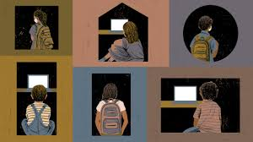
COVID-19 and Children's Mental Health
Elementary K-5

Slide 21
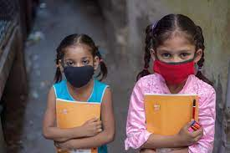
How is the Covid-19 Pandemic Affecting Children?
Children are experiencing many of the same impacts as adolescents
  School closures
  Not getting to see friends and peers
  Change in routine
  Break in continuity of learning
  Break in continuity of health care
  Missed significant life events
  Loss of security and safety
  Many children’s social, emotional, and mental well-being has been impacted by the pandemic.

Slide 22

Developmental Tasks of Children (6-11 yrs old)
Children of this age range ask a lot of questions! They are eager to learn about the world and acquire new skills
Children are very aware of rules- they may not always follow them, but they are testing limits and beginning to understand why they exist
Developmental Tasks:
Accepting and following rules
Learning new skills
Selecting adult role models
Learning how the world works
Increasing independence
Enhancing ability to reason
Becoming more cooperative

Slide 23
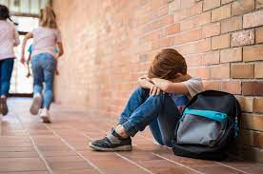
Mental Health and Children
Younger children may not know how to talk about their feelings and will instead show changes in their behavior or development
Children may fear going to school and spending time with friends
Trouble paying attention/ concentration
Some children may become aggressive/ behavior changes
Children might begin to regress and act younger than their age
Sudden change in mood
Hard time falling or staying asleep
Changes in appetite

Slide 24
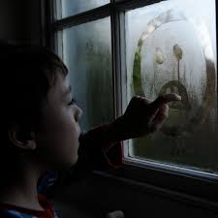
Helping Children Cope
“Anything that’s human is mentionable, and anything that is mentionable can be more manageable. When we can talk about our feelings, they become less overwhelming, less upsetting, and less scary. The people we trust with that important talk can help us know that we are not alone.” – Mr. Rogers
Most children want to talk about things that make them feel anxious or stressed- so let them.
(zerotothree.org)
(SAHMSA)

Slide 25
Discussing COVID-19 with Children
Covid-19 can be a difficult subject for parents to talk about with children
It is natural to want to “protect” children from this information
Children are able to detect emotional changes in their family, and they will most likely have questions that they want to be answered
  Provide children with basic information
  Develop a shared understanding within the family
  School aged children will have a basic understanding of what the virus is and understand that it is dangerous
  Make sure to tailor your explanation to fit your child’s age

Slide 26

The Role of Parents and Guardians
Children look to adults for guidance on how to react to stressful events- parents/ guardians set the tone in the household
  Stay calm- listen- and offer reassurance
  Be a role model- children will learn from your example
  Be aware of how you talk about COVID-19- your conversations on the topic can increase or decrease fear
  Explain social distancing
  Focus on the positive- celebrate some of the positives of spending more time with family
  Establish and maintain a daily routine- a regular schedule provides a sense of control
  Pay attention and be a good listener

Slide 27
The Role of Parents and Guardians cont.
Monitor television and social media
  Developmentally inappropriate information can cause an increase in anxiety and fear
Take time to talk and answer questions truthfully
  Remain calm, reassure children that they are safe (it is okay to feel upset)
Be honest and accurate
  Talk to children about how some stories on COVID-19 that they hear on the internet or TV might be based on rumors and could be inaccurate
  Remember that your own well-being is important!

Slide 28
Additional Resources
Supporting Students’ Mental Health During COVID
https://childmind.org/article/supporting-students-mental-health/
Zero to Three- Early Connections Last a Lifetime
https://www.zerotothree.org/resources/3374-setting-limits
Developmental Tasks The Center for Parenting Education
https://centerforparentingeducation.org
COVID-19 Parental Resources Kit- Childhood: CDC
Helping Children Cope with Changes Resulting from COVID-19
https://www.nasponline.org
Mental Health During Covid-19: Signs your Child May Need More Support
Healthychildrne.org
Talking with Children: Tips for Caregivers, Parents, and Teachers During Infectious Disease Outbreaks: SAHMSA
Discussing Coronavirus with Your Children: Center for the Study of Traumatic Stress

Slide 29

Additional Resource
Supporting Stress and Mental Health in Students with Autism During
COVID 19; A Toolkit for Caregivers and Providers
https://www.wssd.org/Page/12256

